Slide 1
Linked Lists
Carl Qi & Kevin Wang
Notes:
Original slides from Kelly and Kyle

Slide 2
Slides:
https://tinyurl.com/yxoh4ept

Slide 3
Linked List Class
class Link: empty = () def __init__(self, first, rest=empty):
assert rest is Link.empty or isinstance(rest, Link) self.first = first self.rest = rest
Linked lists as classes allow for easy mutability
Can access attributes with
lst.first
lst.rest
Link.empty for empty lists
Notes:
Carl

Slide 4
Linked List Class cont.
def __repr__(self): if self.rest:
rest_str = “, “ + repr(self.rest) else:
rest_str = “”
return 'Link({0}, {1})'.format(repr(self.first), rest_str)
def __str__(self):
string = “<”
while self.rest is not Link.empty:
String += str(self.first) + “ “
Self = self.rest
return string + str(self.first) + “>”
Notes:
Kevin

Slide 5
Box and Pointer (taken from summer Lecture 9)
Link(1, Link(2, Link(3)))
Value of the rest is an arrow (pointer) to another link
1
2
3
Value of the first is the number 1
empty terminates the list
Notes:
Carl

Slide 6
Warm up!
Draw the resulting linked list!
x = Link(1, Link(2)) y = Link(3) z = x.rest
y.rest = x x.rest = Link(x) y.rest.rest.rest = y
Notes:
Carl

Slide 7
Linked List Diagram (Brian Hou’s Quiz 6)
Draw the box and pointer diagram for the given code:
l = Link(0)
for e in range(1, 3):
l = Link(e, Link(l, l))
l.rest.rest.rest = l.rest
Notes:
Kevin

Slide 8
Linked List Diagram (Brian Hou’s Quiz 6) Solutions
Draw the box and pointer diagram for the given code:
l = Link(0)
for e in range(1, 3):
l = Link(e, Link(l, l))
l.rest.rest.rest = l.rest
1
2
l →
Notes:
Kevin

Slide 9
Meha’s Linked List Problem
Warm-up
def trim(s, index):
"""
>>> s1 = Link(1, Link(2, Link(3)))
>>> trim(s1, 0) # Returns the trimmed part
Link(2, Link(3))
>>> s1
Link(1)
>>> s2 = Link(1, Link(2, Link(3)))
>>> trim(s2, 2) == Link.empty # No elements after index 2
True
>>> s2
Link(1, Link(2, Link(3)))
>>> s3 = Link(1, Link(2, Link(3)))
>>> trim(s3, 3) # s3 has no index 3
Traceback (most recent call last):
...
IndexError
"""
Implement trim(s, index), where s is an instance of the Link class and index is a non-negative integer. The trim function mutates s so that all elements that occur after the index are removed. The trim function should also return a linked list of all of the removed elements. If the index exceeds the linked list, raise an IndexError. Your solution must use recursion; you may not use iteration.
You may NOT assume that get and len have been implemented.
Notes:
Carl

Slide 10
Meha’s Linked List Problem : Solution
Warm-up
def trim(s, index):
"""
>>> s1 = Link(1, Link(2, Link(3)))
>>> trim(s1, 0) # Returns the trimmed part
Link(2, Link(3))
>>> s1
Link(1)
"""
if s is Link.empty:
raise IndexError
elif index == 0:
result = s.rest
s.rest = Link.empty
return result
else:
return trim(s.rest, index - 1)
Tips:
Draw out the diagram
Think about how to decrease the problem to a base case
Notes:
Carl

Slide 11
Summer 2014 Final #8
Exam-level
Define shuffle, which takes in a linked list and uses mutation to create a linked list with every pair of elements in the original list swapped (see the doctests). Your function must return a linked list, but that list must be created using only mutation of the rest attribute.
You may NOT call the Link constructor.
You may NOT assign to the first attribute. The point of this problem is to mutate rest attributes. USE RECURSION.
def shuffle ( lst ):
"""
>>> shuffle(Link(1, Link(2, Link(3, Link(4)))))
Link (2 , Link (1 , Link (4 , Link (3))))
>>> shuffle ( Link (‘s’, Link (‘c’, Link (1 , Link (6 , Link (‘a’))))))
Link (‘c’, Link (‘s’, Link (6 , Link (1 , Link (‘a’)))))
"""
if ______________________________________________
return ______________________________________
new_head = lst.rest
lst.rest = ______________________________________ _________________________________________________
return___________________________________________
Notes:
Kevin

Slide 12
Summer 2014 Final #8 : Solution
Exam-level
def shuffle(lst):
"""
>>> shuffle(Link(1, Link(2, Link(3, Link(4)))))
Link(2, Link(1, Link(4, Link(3))))
>>> shuffle(Link(‘s’, Link(‘c’, Link(1 , Link(6, Link(‘a’))))))
Link(‘c’, Link(‘s’, Link(6 , Link(1 , Link(‘a’)))))
"""
if
return
new_head = lst.rest
lst.rest =
return
Notes:
Kevin

Slide 13
Summer 2014 Final #8 : Solution
Exam-level
def shuffle(lst):
"""
>>> shuffle(Link(1, Link(2, Link(3, Link(4)))))
Link(2, Link(1, Link(4, Link(3))))
>>> shuffle(Link(‘s’, Link(‘c’, Link(1 , Link(6, Link(‘a’))))))
Link(‘c’, Link(‘s’, Link(6 , Link(1 , Link(‘a’)))))
"""
if lst is Link.empty or lst.rest is Link.empty:
return lst
new_head = lst.rest
lst.rest = shuffle(new_head.rest)
new_head.rest = lst
return new_head
Tips:
Draw out the diagram
Think about the base case first
Work from the smallest case out
Keep track of what each recursive call returns

Slide 14
Summer 2014 Final #8 without Mutation
Exam-level
Define shuffle, which takes in a linked list and creates a linked list with every pair of elements in the original list swapped (see the doctests).
Your function must return a new linked list.
def shuffle (lst):
"""
>>> shuffle(Link(1, Link(2, Link(3, Link(4)))))
Link (2 , Link (1 , Link (4 , Link (3))))
>>> l = Link (‘s’, Link (‘c’, Link (1 , Link (6 , Link (‘a’)))))
>>> shuffle(l)
Link (‘c’, Link (‘s’, Link (6 , Link (1 , Link (‘a’)))))
>>> l
Link (‘s’, Link (‘c’, Link (1 , Link (6 , Link (‘a’)))))
"""

Slide 15
Summer 2014 Final #8 without Mutation : Solution
Exam-level
def shuffle(lst):
"""
>>> shuffle(Link(1, Link(2, Link(3, Link(4)))))
Link (2 , Link (1 , Link (4 , Link (3))))
>>> l = Link (‘s’, Link (‘c’, Link (1 , Link (6 , Link (‘a’)))))
>>> shuffle(l)
Link (‘c’, Link (‘s’, Link (6 , Link (1 , Link (‘a’)))))
>>> l
Link (‘s’, Link (‘c’, Link (1 , Link (6 , Link (‘a’)))))
"""
Notes:
Carl

Slide 16
Summer 2014 Final #8 without Mutation : Solution
Exam-level
def shuffle(lst):
"""
>>> shuffle(Link(1, Link(2, Link(3, Link(4)))))
Link (2 , Link (1 , Link (4 , Link (3))))
>>> l = Link (‘s’, Link (‘c’, Link (1 , Link (6 , Link (‘a’)))))
>>> shuffle(l)
Link (‘c’, Link (‘s’, Link (6 , Link (1 , Link (‘a’)))))
>>> l
Link (‘s’, Link (‘c’, Link (1 , Link (6 , Link (‘a’)))))
"""
if lst is Link.empty or lst.rest is Link.empty:
return lst
new_head = Link(lst.rest.first)
new_tail = Link(lst.first, shuffle(lst.rest.rest))
new_head.rest = new_tail
return new_head
Notes:
Carl

Slide 17
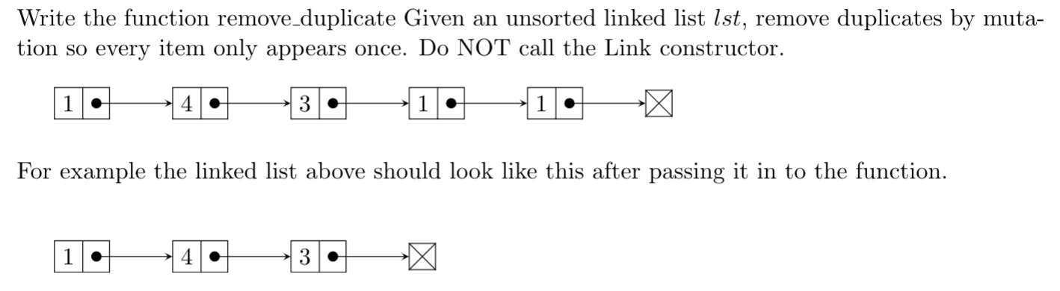
Remove Duplicates
Exam-level
Notes:
Kevin

Slide 18
Remove Duplicates: Solution
Exam-level
def remove_duplicate(lst):
while (_______________________________________________):
temp = lst
while (temp.rest is not Link.empty):
if (temp.rest.first == __________________):
next = __________________
temp.rest = _______________
else:
temp = _________________
lst = _________________
Notes:
Kevin

Slide 19
Remove Duplicates: Solution
Exam-level
def remove_duplicate(lst):
while (lst is not Link.empty and lst.rest is not Link.empty):
temp = lst
while (temp.rest is not Link.empty):
if (temp.rest.first == lst.first):
next = temp.rest.rest
temp.rest = next
else:
temp = temp.rest
lst = lst.rest
Python Tutor: https://goo.gl/c56nT1
Notes:
Kevin

Slide 20
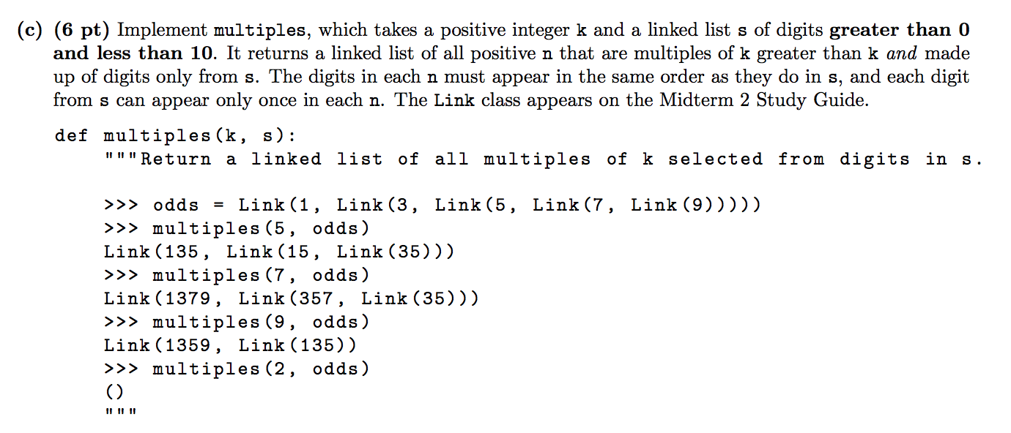
Fall 2015 Midterm 2 Q3c
Notes:
Kevin

Slide 21
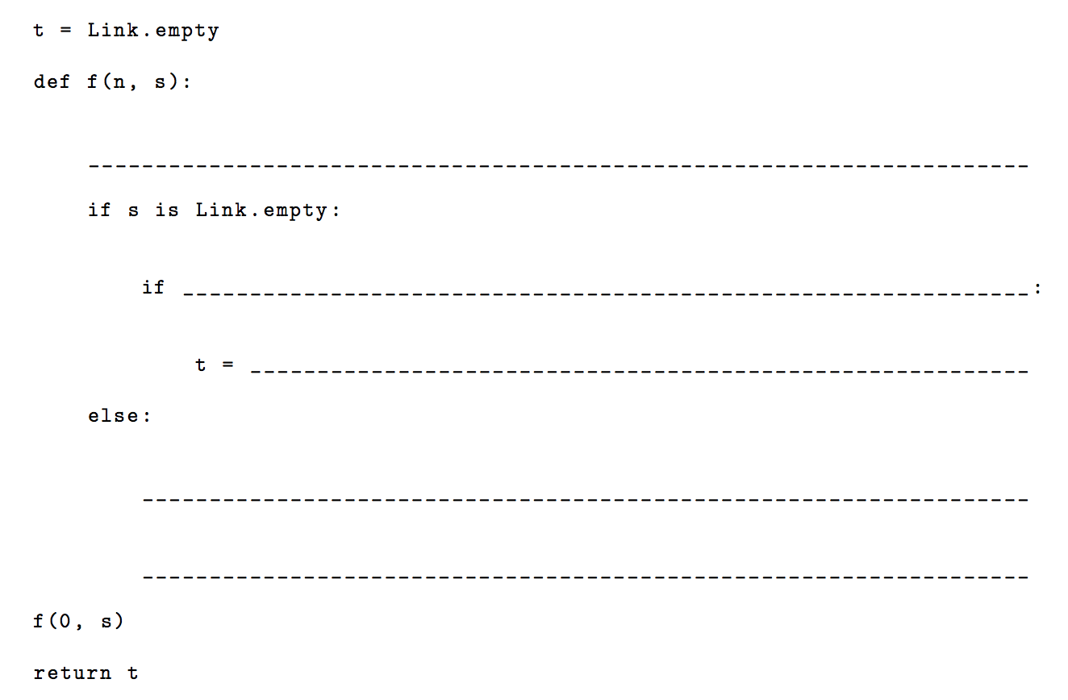
Notes:
Kevin

Slide 22
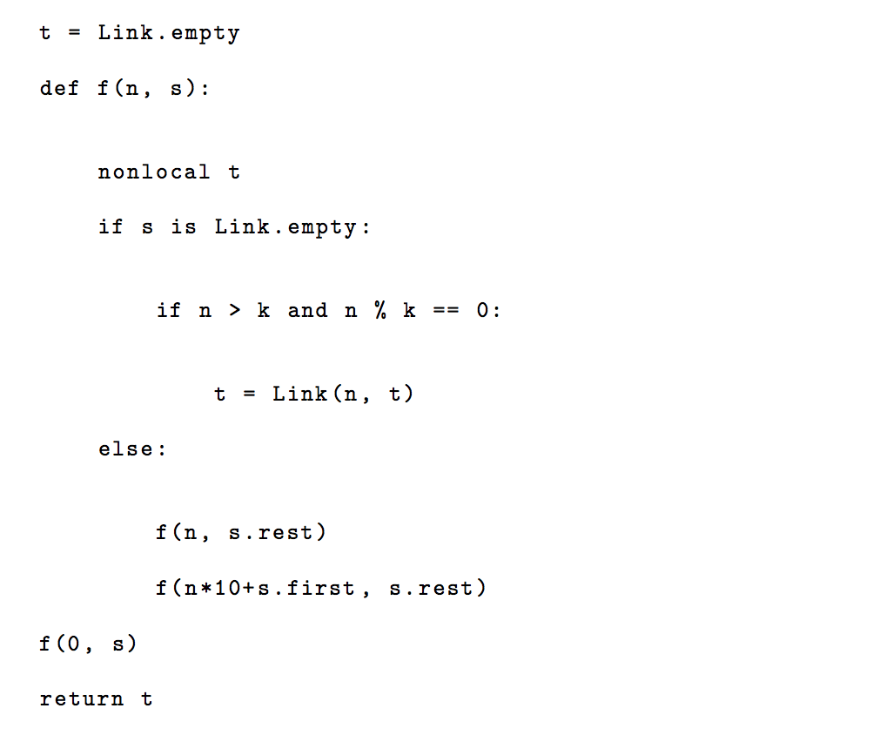
Notes:
Kevin

Slide 23
Tips and Tricks
2 main ways of building a new linked list:
Starting off with lnk = Link.empty and constantly updating lnk lnk = Link(<some value>, lnk)
Recursively building your linked list Link(<some value>, <recursive call>)
You’ll usually need this line: lnk = lnk.rest
Notes:
Kevin & Carl

